Slide 1
MODULE 3
SEQUENTIAL LOGIC CIRCUITS

Slide 2
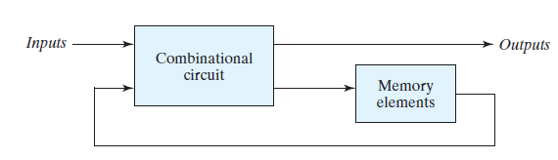
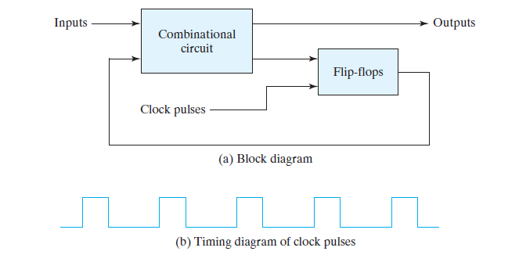


Slide 3

Storage elements that operate with signal levels (rather than signal transitions) are referred to as latches ; those controlled by a clock transition are flip-flops .
The SR latch is a circuit with two cross-coupled NOR gates or two cross-coupled NAND gates, and two inputs labeled S for set and R for reset.
The latch has two useful states. When output Q = 1 and Qbar = 0, the latch is said to be in the set state . When Q = 0 and Qbar = 1, it is in the reset state .

Slide 4
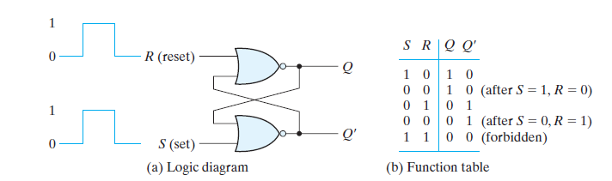


Slide 5
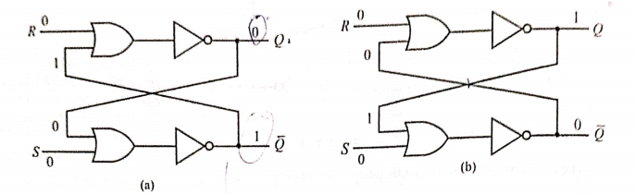
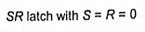
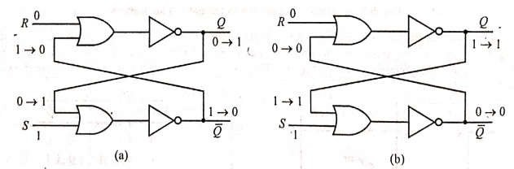
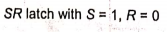

Slide 6
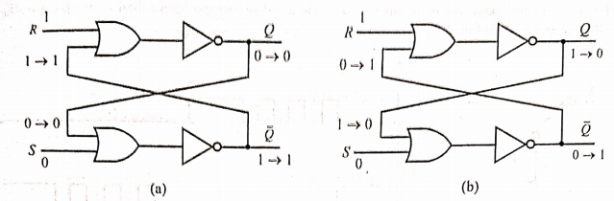
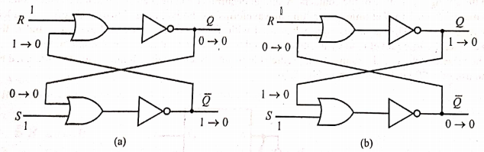

Slide 7
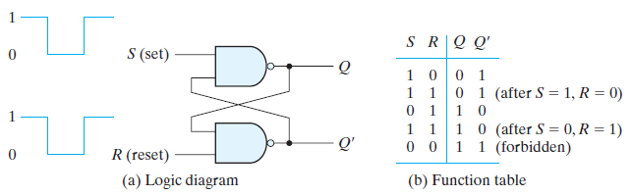
The operation of the basic SR latch can be modified by providing an additional input signal that determines (controls) when the state of the latch can be changed by determining whether S and R (or S’ and R’ ) can affect the circuit.

Slide 8
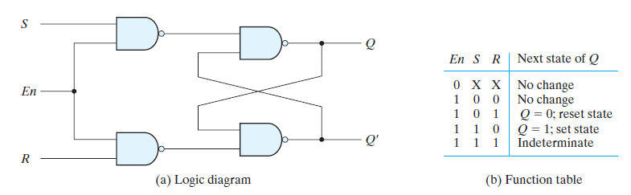

Slide 9

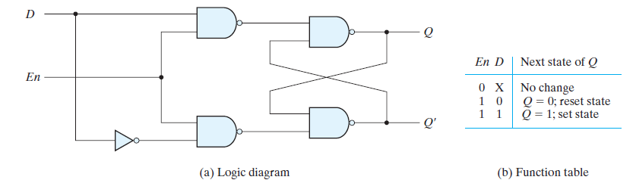
One way to eliminate the undesirable condition of the indeterminate state in the SR
latch is to ensure that inputs S and R are never equal to 1 at the same time. This is
done in the D latch.

Slide 10
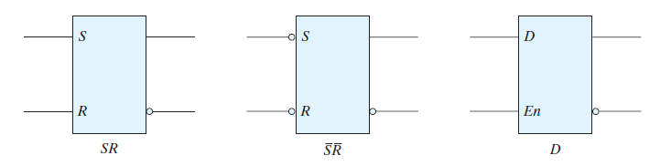
This latch has only two inputs: D (data) and En (enable). The D input goes directly to the S input, and its complement is applied to the R input.

Slide 11
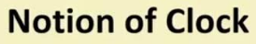
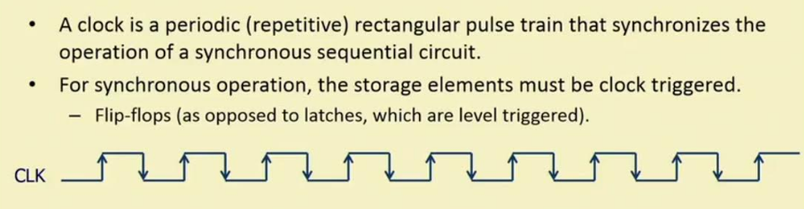

Slide 12
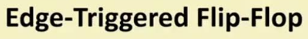
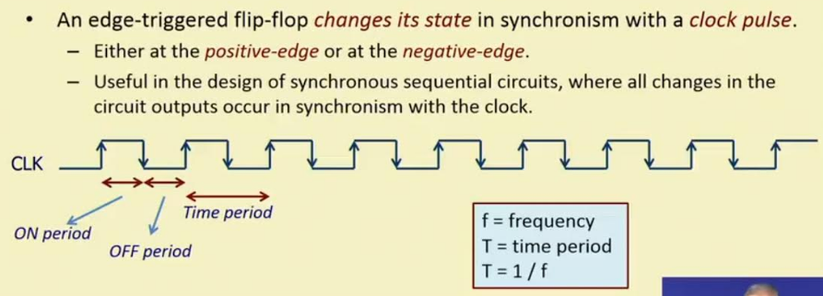

Slide 13
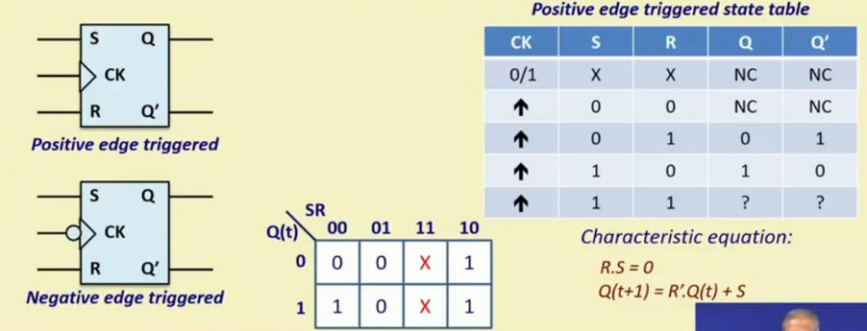


Slide 14
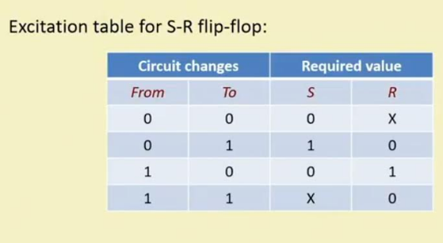

Slide 15
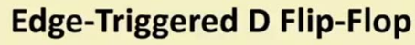
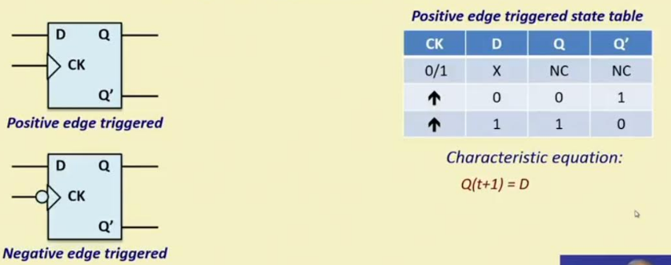


Slide 16
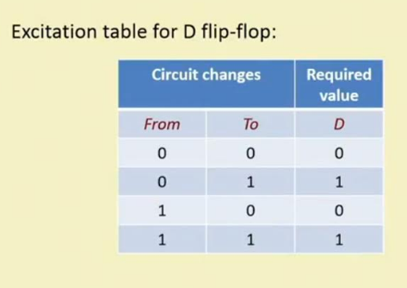

Slide 17
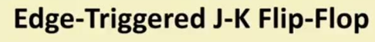
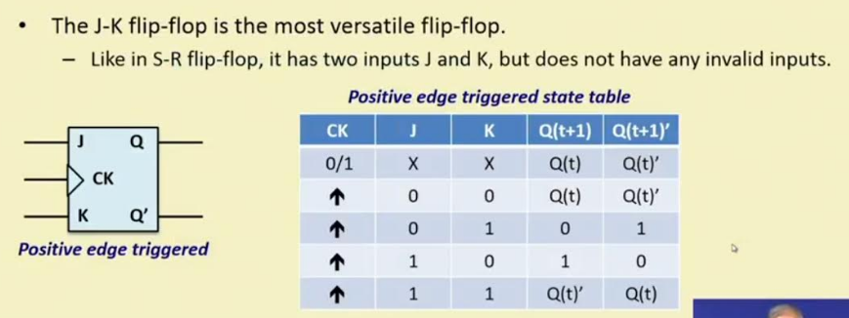


Slide 18
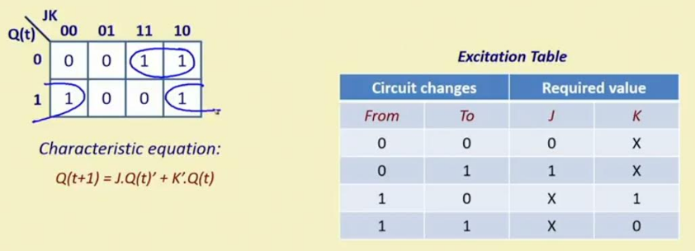

Slide 19
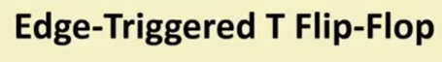
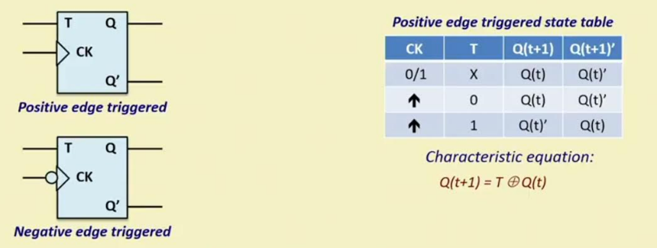

Slide 20
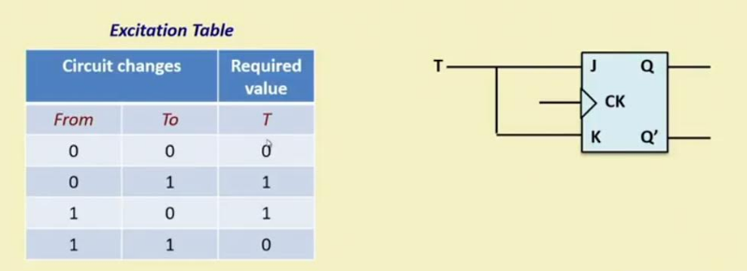

Slide 21
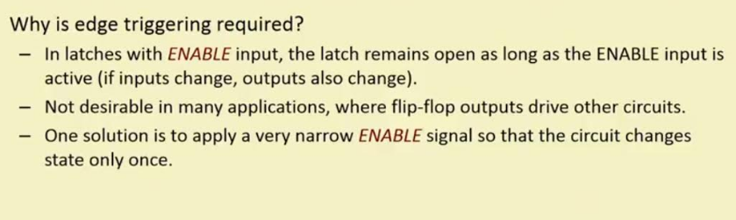

Slide 22
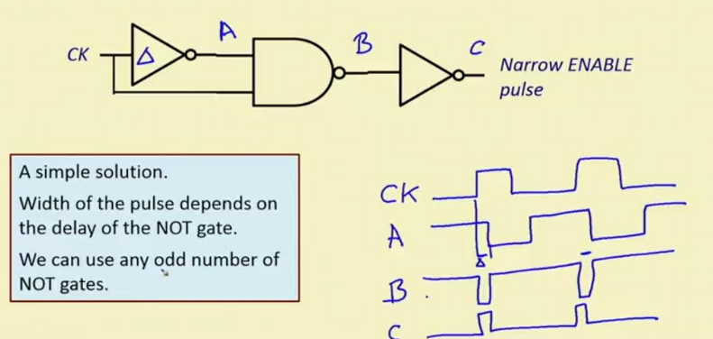
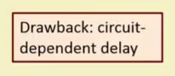

Slide 23

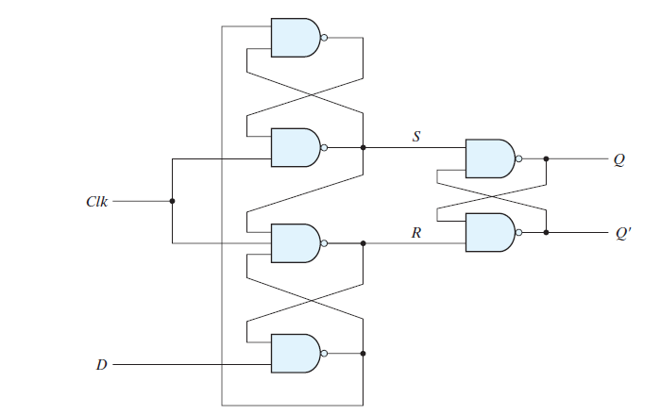

Slide 24
Two latches respond to the external D (data) and Clk (clock) inputs. The third latch provides the outputs for the flip-flop. The S and R inputs of the output latch are maintained at the logic-1 level when Clk = 0. This causes the output to remain in its present state.

Slide 25
The S and R inputs of the output latch are maintained at the logic-1 level when Clk = 0. This causes the output to remain in its present state. Input D may be equal to 0 or 1
1
0
No Change
No Change
1

Slide 26
If D = 0 when Clk changes 1, R changes to 0. This causes the flip-flop to go to the reset state, making Q = 0.
This causes the flip-flop to go to the reset state, making Q = 0.
1
0
1
1
0
0 - 1
0
1
1
1
1 - 0
0
0
1

Slide 27
NOTE:
If there is a change in the D input while Clk = 1, terminal R remains at 0. Thus, the flip-flop is locked out and is unresponsive to further changes in the input.
When the clock returns to 0, R goes to 1, placing the output latch in the quiescent condition without changing the output.
Similarly, if D = 1 when Clk goes from 0 to 1, S changes to 0. This causes the circuit to go to the set state, making Q = 1. Any change in D while Clk = 1 does not affect the output.

Slide 28
There is a minimum time called the setup time during which the D input must be maintained at a constant value prior to the occurrence of the clock transition.
Similarly, there is a minimum time called the hold time during which the D input must not change after the application of the positive transition of the clock.
The propagation delay time of the flip-flop is defined as the interval between the trigger edge and the stabilization of the output to a new state.

Slide 29
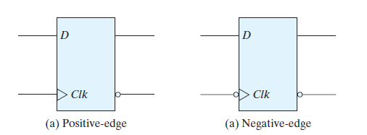
The arrowhead-like symbol in front of the letter Clk, designating a dynamic input. The dynamic indicator (>) denotes the fact that the flip-flop responds to the edge transition of the clock.
A bubble outside the block adjacent to the dynamic indicator designates a negative edge for triggering the circuit.
The absence of a bubble designates a positive-edge response.

Slide 30

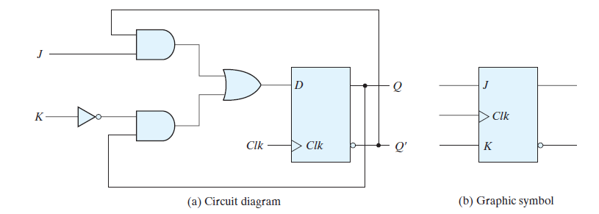
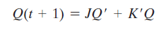

Slide 31

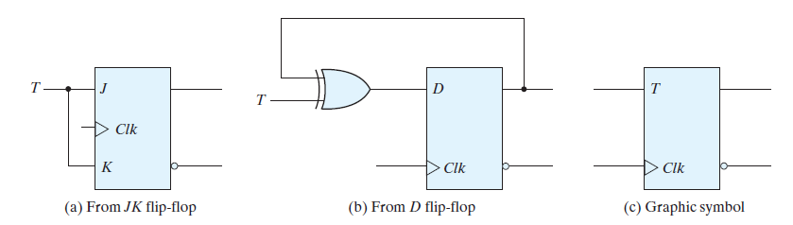
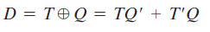

Slide 32
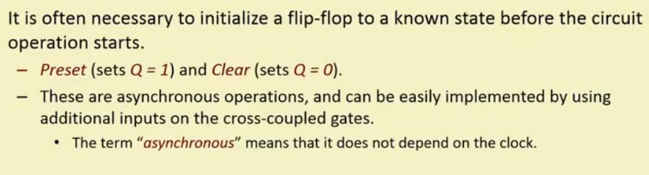

Slide 33
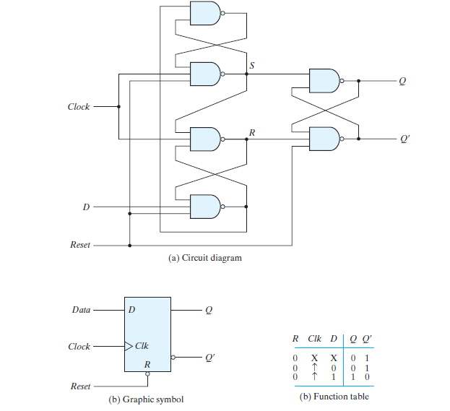

Slide 34

Some flip-flops have asynchronous inputs that are used to force the flip-flop to a particular state independently of the clock.
The input that sets the flip-flop to 1 is called preset or direct set . The input that clears the flip-flop to 0 is called clear or direct reset .
When power is turned on in a digital system, the state of the flip-flops is unknown. The direct inputs are useful for bringing all flip-flops in the system to a known starting state prior to the clocked operation.

Slide 35
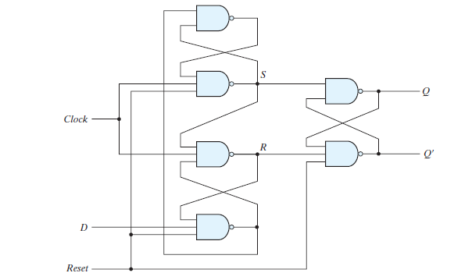
A positive-edge-triggered D flip-flop with active-low asynchronous reset is shown above . The circuit diagram is the same as the earlier one , except for the additional reset input connections to three NAND gates.
When the reset input is 0, it forces output Q to stay at 1, which, in turn, clears output Q to 0, thus resetting the flip-flop.
Two other connections from the reset input ensure that the S input of the third SR latch stays at logic 1 while the reset input is at 0, regardless of the values of D and Clk .

Slide 36
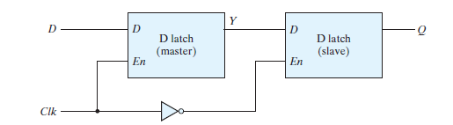

Slide 37

A register is a group of flip‐flops, each one of which shares a common clock and is capable of storing one bit of information. An n ‐bit register consists of a group of n flip‐flops capable of storing n bits of binary information.
A counter is essentially a register that goes through a predetermined sequence of binary states. The gates in the counter are connected in such a way as to produce the prescribed sequence of states.

Slide 38
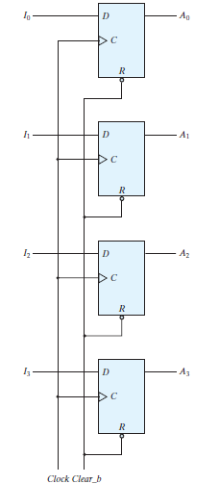
Various types of registers are available commercially. The simplest register is one that consists of only flip‐flops, without any gates.
The common clock input triggers all flip‐flops on the positive edge of each pulse, and the binary data available at the four inputs are transferred into the register
The input Clear_b goes to the active‐low R (reset) input of all four flip‐flops. When this input goes to 0, all flip‐flops are reset asynchronously.
The Clear_b input is useful for clearing the register to all 0’s prior to its clocked operation.

Slide 39

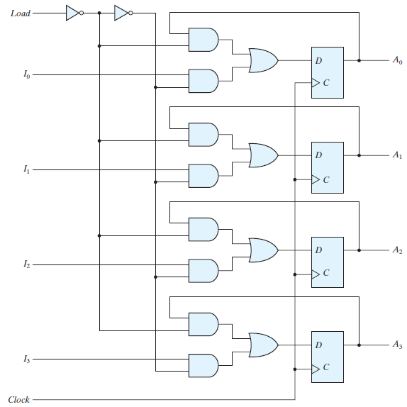
When the load input is 1, the data at the four external inputs are transferred into the register with the next positive edge of the clock.
When the load input is 0, the outputs of the flip‐flops are connected to their respective inputs.
The feedback connection from output to input is necessary because a D flip‐flop does not have a “no change” condition.
The load input determines whether the next pulse will accept new information or leave the information in the register intact.
Selector

Slide 40
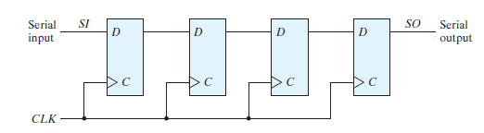
A register capable of shifting the binary information held in each cell to its neighboring cell, in a selected direction, is called a shift register.
The logical configuration of a shift register consists of a chain of flip‐flops in cascade, with the output of one flip‐flop connected to the input of the next flip‐flop.
All flip‐flops receive common clock pulses, which activate the shift of data from one stage to the next.

Slide 41

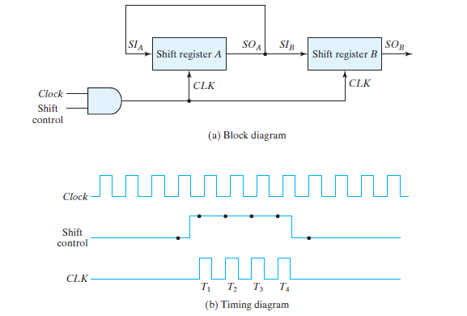

Slide 42
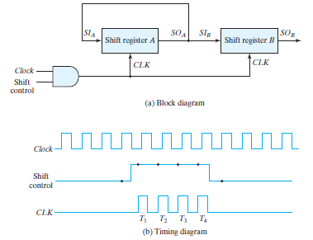
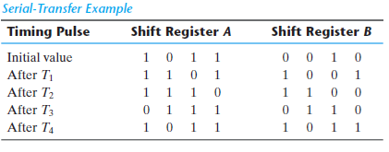

Slide 43
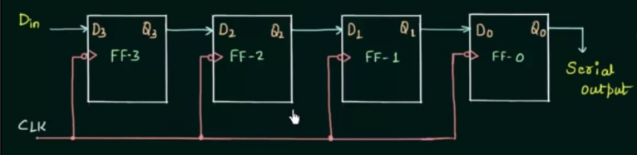
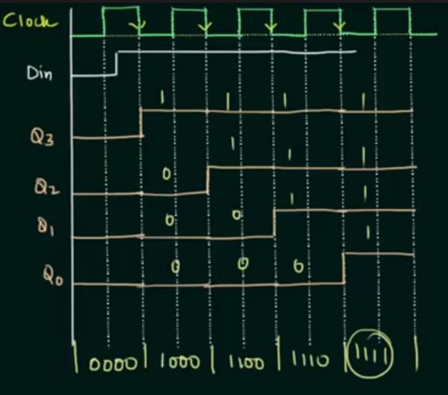
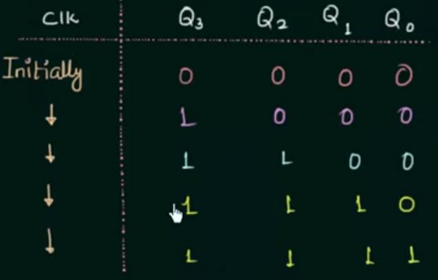
SERIAL IN SERIAL OUT REGISTER

Slide 44

VERILOG CODE FOR SERIAL IN SERIAL OUT

Slide 45

SERIAL IN PARALLEL OUT

Slide 46

VERILOG CODE FOR SERIAL IN PARALLEL OUT

Slide 47

PARALLEL IN PARALLEL OUT

Slide 48

VERILOG CODE FOR PARALLEL IN PARALLEL OUT

Slide 49


PARALLEL IN SERIAL OUT

Slide 50

VERILOG CODE FOR PARALLEL IN SERIAL OUT

Slide 51




Slide 52


To show that serial operations can be designed by means of sequential circuit procedure, we will redesign the serial adder with the use of a state table.

Slide 53




Slide 54



Slide 55




Slide 56



Slide 57



Slide 58


Slide 59



Slide 60
Computing Next State Values
The next-state values can also be obtained by evaluating the state equations from the characteristic equation. This is done by using the following procedure:
Determine the flip-flop input equations in terms of the present state and input variables.
2. Substitute the input equations into the flip-flop characteristic equation to obtain the state equations.
3. Use the corresponding state equations to determine the next-state values in the state table.

Slide 61







Example 1

Slide 62





Slide 63
State Equations
The behavior of a clocked sequential circuit can be described algebraically by means of
state equations. A state equation (also called a transition equation ) specifies the next
state as a function of the present state and inputs.
State Table
The time sequence of inputs, outputs, and flip-flop states can be enumerated in a state table (sometimes called a transition table ). In general, a sequential circuit with m flipflops and n inputs needs 2^(m+n) rows in the state table.
The binary numbers from 0 through 2^(m+n) - 1 are listed under the present-state and input columns. The next-state section has m columns, one for each flip-flop.
State Diagram
The information available in a state table can be represented graphically in the form
of a state diagram. In this type of diagram, a state is represented by a circle, and the
(clock-triggered) transitions between states are indicated by directed lines connecting the circles.

Slide 64





Example 2

Slide 65




Example 3

Slide 66


Slide 67




Input Equations

Slide 68







Example 4

Slide 69


Slide 70
The most general model of a sequential circuit has inputs, outputs, and internal states.
It is customary to distinguish between two models of sequential circuits: the Mealy model and the Moore model.
In the Mealy model, the output is a function of both the present state and the input.
In the Moore model, the output is a function of only the present state.
The two models of a sequential circuit are commonly referred to as a finite state machine, abbreviated FSM.
The Mealy model of a sequential circuit is referred to as a Mealy FSM or Mealy machine. The Moore model is referred to as a Moore FSM or Moore machine.

Slide 71


Slide 72


Example of a Mealy machine:
Output y is a function of both input x and the present state of A and B. The corresponding state diagram shows both the input and output values, separated by a slash along the directed lines between the states.

Slide 73


An example of a Moore model:
Here, the output is a function of the present state only.
The corresponding state diagram has only inputs marked along the directed lines. The outputs are the flip-flop states marked inside the circles.

Slide 74

Another example of a Moore model is the sequential circuit shown below. The output
depends only on flip-flop values, and that makes it a function of the present state only.
The input value in the state diagram is labeled along the directed line, but the output
value is indicated inside the circle together with the present state.

Slide 75




Slide 76
A counter that follows the binary number sequence is called a binary counter .
An n ‐bit binary counter consists of n flip‐flops and can count in binary from 0 through 2n - 1.
Counters are available in two categories: ripple counters and synchronous counters.
In a ripple counter, a flip‐flop output transition serves as a source for triggering other
flip‐flops. In other words, the C input of some or all flip‐flops are triggered, not by the common clock pulses, but rather by the transition that occurs in other flip‐flop outputs.
In a synchronous counter, the C inputs of all flip‐flops receive the common clock.

